Slide 1
Weekly Update #8
Gijs Admiraal

Slide 2
Recap from previous weeks
Started exploring topics: atom-by-atom generation, non-standard amino acids (nsAA), (chemical) language models, data augmentation and 3Di
Started creating protein SMILES dataset with RDKit
Created a mind map
Brainstormed and written out scenario#2 All-atom in a diffusion setting

Slide 3
What I have done
Worked on the research question
With sub-questions
Data analysis
Length distribution
Amino acid distribution

Slide 4
What I have done
Worked on the research question
With sub-questions
Data analysis
Length distribution
Amino acid distribution

Slide 5
Research question
What is the [EVALUATION] performance of training on an all-atom sequence representation using SMILES and how does it compare to other representations such as amino acids sequence when using a [DIFFUSION TYPE] & [ARCHITECTURE] diffusion model for de novo generative protein design with [OBJECTIVE]?
Still need to fill in evaluation, diffusion type & architecture and objective

Slide 6
Research sub-questions
Does the performance of the model increase significantly when using the data augmentation method as specified by J. Arus-Pous, et al. (2019)¹
Does the performance of the model trained on the all-atom representation increase significantly when additional structural information in the form of a 3Di sequence² is combined with the protein sequence and diffused? Or when the 3Di sequence is only provided to the model through attention heads
Does the model trained on the all-atom representation have the same performance when tested on different subsets of proteins lengths.
Is the model trained on the all-atom representation when fine-tuned on protein sequences with unnatural amino acids able to correctly learn the training distribution.
What is the performance of the model trained on the all-atom representation when performing inpainting tasks

Slide 7
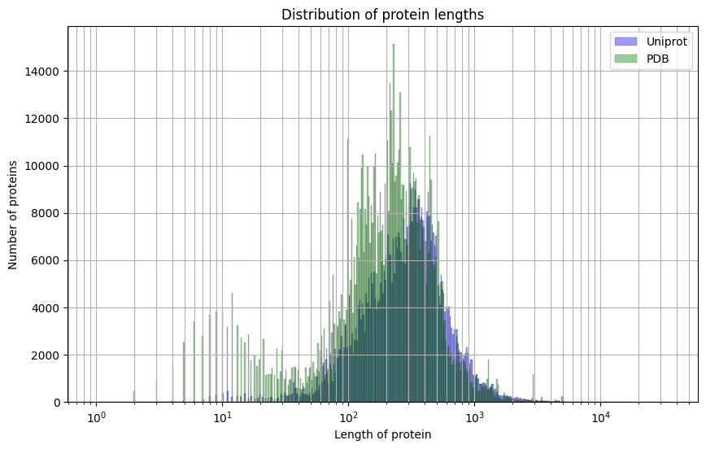
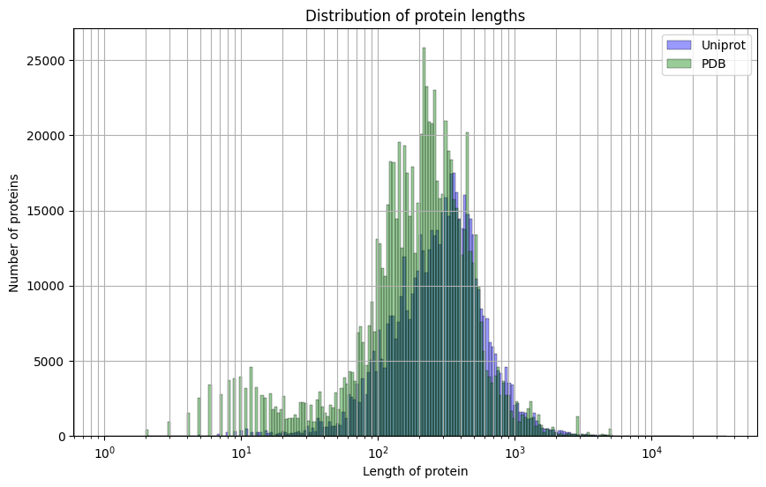
Length Distribution

Slide 8
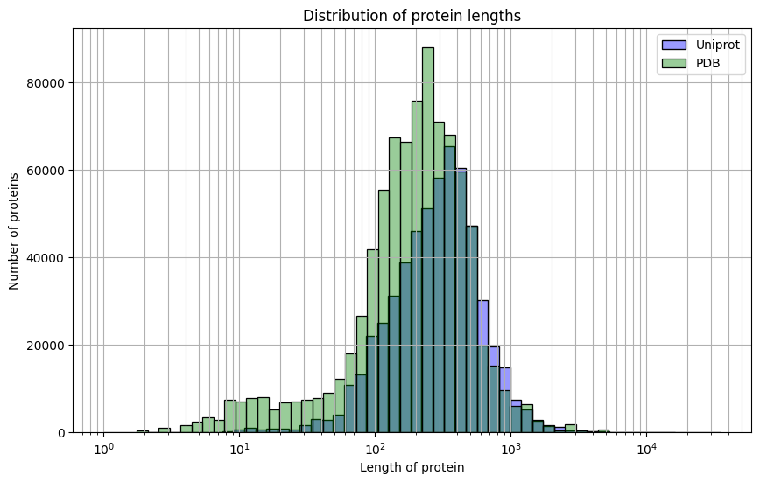
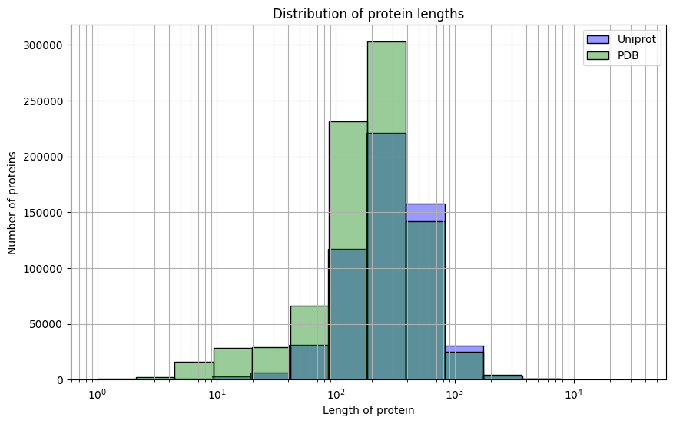
Length Distribution

Slide 9
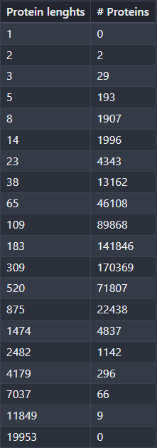
Length distribution

Slide 10
What I have done
Worked on the research question
With sub-questions
Data analysis
Length distribution
Amino acid distribution

Slide 11
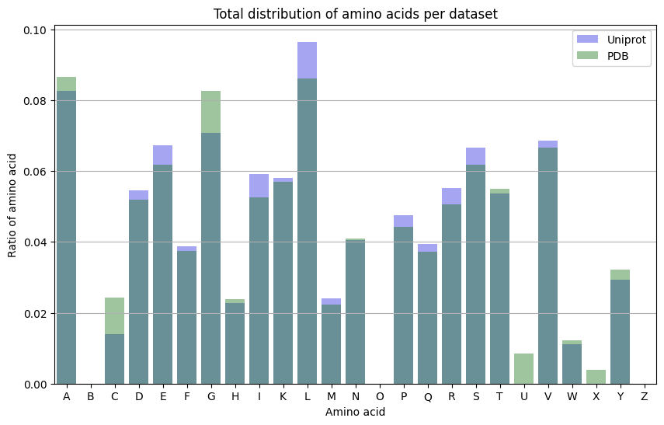
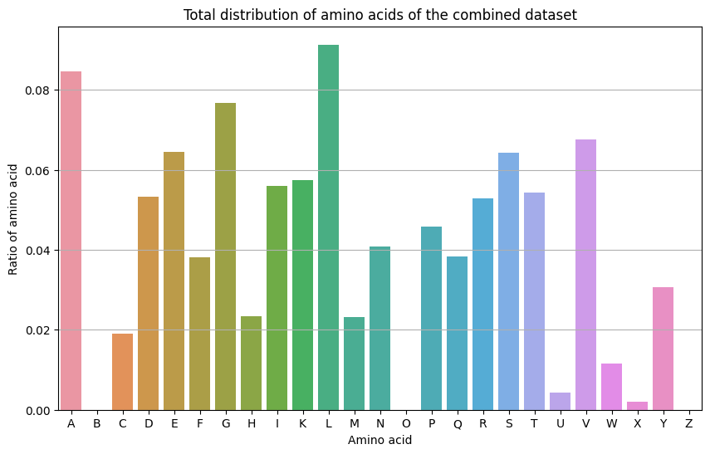
Total amino acid distribution

Slide 12
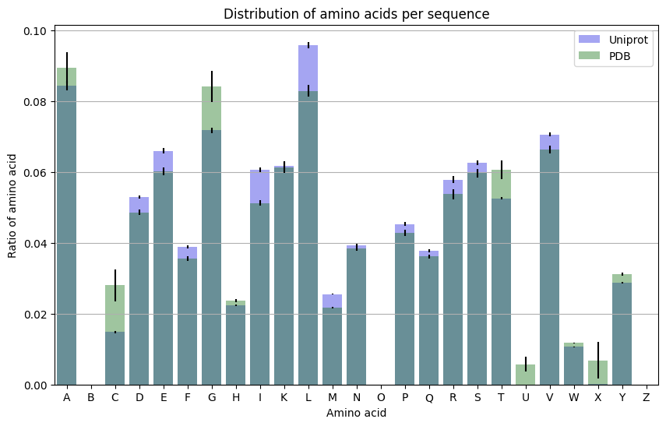
Amino acid distribution per sequence

Slide 13
More data analysis?
Look at the distribution of protein families?
Look at the distribution of protein function?
How diverse are the sequence to each other?
How to best do this?
>sp|Q6GZX2|003R_FRG3G Uncharacterized protein 3R OS=Frog virus 3 (isolate Goorha) OX=654924 GN=FV3-003R PE=3 SV=1
VSSAVELNYHAG……

Slide 14
Next week?
Start experimenting
Start writing a bit
Integrate feedback of current meeting

Slide 15
notes

